Slide 1
Business process modelling notation
BPMN

Slide 2
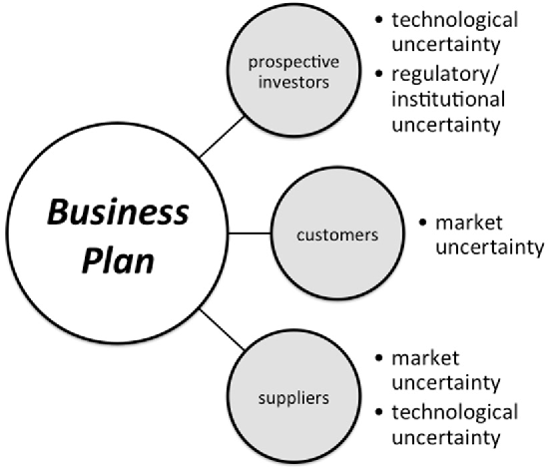
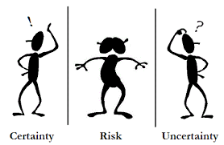
Risks and uncertainty
Do I need more resources?
Do I need more knowledge?
Why does it matter?
Notes:
Weather example

Slide 3
How do we know that ‘this’ is what we need?
Uncertainties manifest themselves as ignorance and doubt.
What do we need? Why do we need it?
Opportunity
Evaluate the opportunity
Personal evaluation (thinking about the opportunity)
Feasibility study (formal evaluation)
Notes:
“Failure to understand the why behind the what results in a project delivering something that fails to meet the real needs of the organization (i.e. failure to ask or answer the question “what are we really trying to achieve?”)”

Slide 4
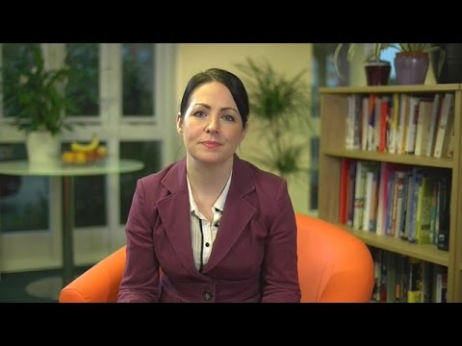
SWOT analysis
Strengths
Weaknesses
Opportunities
Threats
Notes:
https://www.youtube.com/watch?v=PBOtnyt7BP4

Slide 5
What to document and how?
Why do we document the current situation?
To aid analysis – highlight the flaws
Assist with design
To identify change
How do we document it?
A number of techniques such as: Business Process Modelling (e.g. BPMN and Activity diagrams), Use case diagrams (last week).
Use the same techniques to document the proposed system
We are going to use BPMN diagrams
Widely used in Industry
Adaptation of flowcharts
Notes:
Business Process Model and Notation

Slide 6
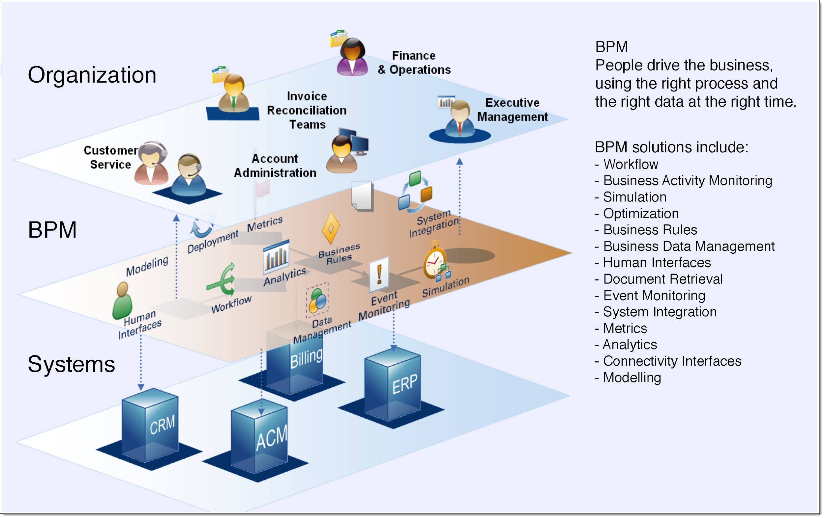
Business Process Modelling
Notes:
Business Process Model and Notation, BPMN, is a process mapping standard from the Object Management Group that was designed to enhance communication between business stakeholders and the IT people who provide systems to support them, especially for processes that can be automated. On the plus side, BPMN employs flowchart like symbols for familiarity. However, BPMN shapes can include numerous visual adornments that can make diagrams complex and hard to read. Like both flowcharts and cross-functional flowcharts, BPMN diagrams are visually helpful, but may not provide sufficient detail about the who, what, where and how of a process.

Slide 7
Business Process Modelling
BPM helps us to understand business current processes and identify opportunities to improve them.
BPM helps leaders maintain consistent processes and adapt to and evolve with changes effectively.
Consistent, standard processes improve efficiency across the board.
BPM helps prevent bottlenecks and miscommunications.

Slide 8
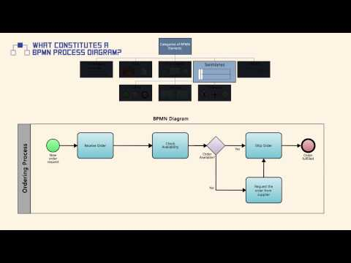
BPMN 2.0
https://www.omg.org/spec/BPMN/2.0/About-BPMN/
Key elements are:
Process
Lane
Events
Tasks
Gateways
Data Objects
Sequence flow
Message flow
Notes:
https://www.youtube.com/watch?v=iMHF1ZStOdE

Slide 9
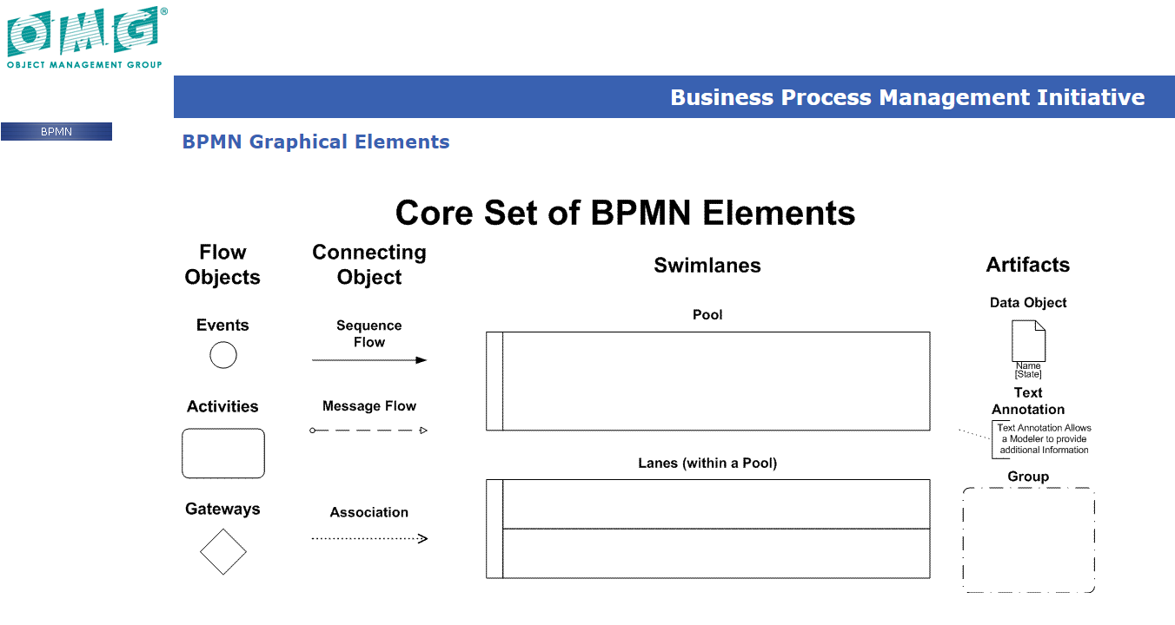
Core BPMN Elements
Notes:
https://www.omg.org/bpmn/Samples/Elements/Core_BPMN_Elements.htm

Slide 10
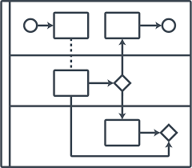
BPMN 2.0 Scope
Provides a notation and model for Business Processes and an unified way to exchange BPMN Process definitions between different tools.
BPMN some out of scope examples:
Definition of organizational models and resources
Modeling of functional breakdowns
Data and information models
Modeling of strategy
Business rules models

Slide 11



BPMN Elements: Events
Start Events indicate the initiation of a process or a Sub-Process.
Intermediate Events indicate something that occurs or is caused during the process.
The End Event indicates where a path in the Process ends.

Slide 12

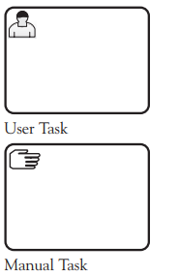
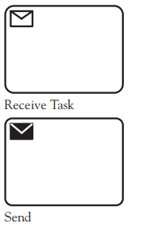
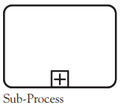
BPMN Elements: Tasks (or activities)
Abstract Task

Slide 13


BPMN Elements: Gateways
Gateways are usually exclusive (only 1 path to follow) or inclusive (1 or more paths to follow).
A parallel gateway will activate all paths and will wait for all processes to finish before activation.

Slide 14
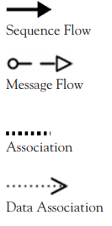
BPMN Elements: Flows
Sequence flow: shows the order in which tasks will be performed.
Message flow: shows the flow between a process's sender and a process's receiver.
Association: is an annotation.
Data association: used to link data with other elements (e.g. tasks).

Slide 15


BPMN Elements: Data
A Data Object represents the data that are used as inputs and outputs to the tasks.
A Data Store is a place where the process can read or write data.

Slide 16
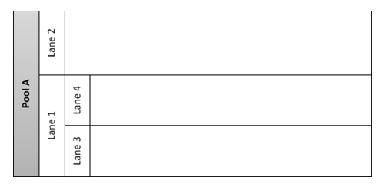
BPMN Elements: Swimlanes
A pool is a container of a process and is superior to a lane.
A lane represents a pool of subordinate role.
Notes:
From: https://blog.goodelearning.com/subject-areas/bpmn/common-bpmn-modeling-mistakes-swimlanes/

Slide 17
How to produce a process map
Consult with the experts.
These are the people managing and working with the process.
Identify the boundaries.
Where does the process begin? where does it end? Some processes will have more than one possible endings.
Identify the participants.
What roles are involved in the processes?
Identify and order the steps.
What is done first? What is done next? By who? You can either stick to the strictly necessary information or choose to go into detail for every action.
Each action should trigger the subsequent step in the process.
Notes:
Process mapping is the act of creating a workflow diagram with the goal of gaining a clearer understanding of how a process and its parallel processes work.

Slide 18
How to produce a process map
Draw an initial process flow.
Make sure you’re using the appropriate symbols to map your processes steps: ovals for the beginning/end of process, rectangles for tasks/steps, diamonds for decision points and arrows to mark the process direction flow.
Normally, only one arrow comes out of each box – if you’re faced with two arrows coming out of a box, you may need to add a decision point.
If the process you’re mapping is cyclical, make sure the feedback loop is closed, taking you back to the beginning.
Check for completeness.
Are all participants represented? Are all processes shown? Are there any alternatives that have not been considered? Refine and finalise.
Review with the experts to ensure completeness.

Slide 19
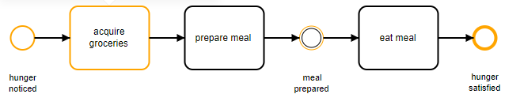
Example
The hungry student

Slide 20
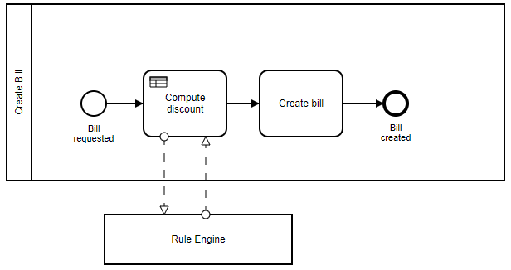
BPMN Example - scenario
Creating a bill: In order to create the bill, a discount needs to be computed. The sum of the order and the customer type are the relevant criteria to compute the discount.
Notes:
This and more examples at: https://camunda.com/bpmn/examples/

Slide 21
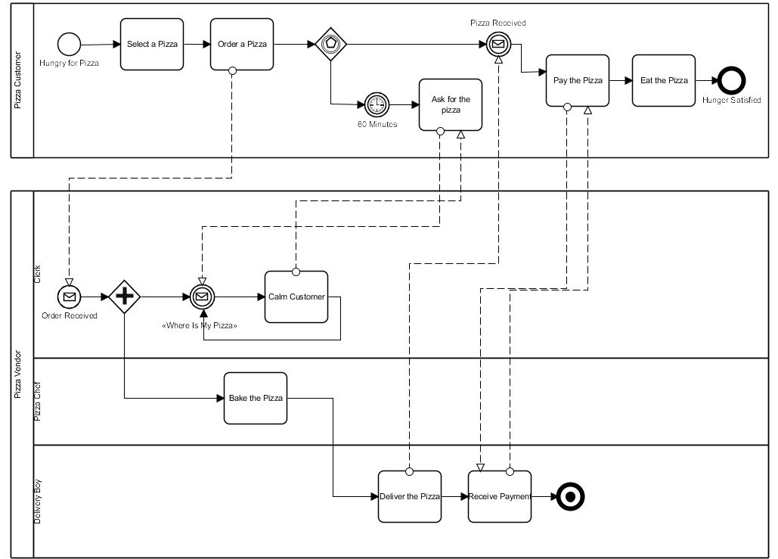
Example:
Pizza
Place
Notes:
From: https://www.businessprocessincubator.com/content/the-pizza-collaboration/

